Slide 1

How safe is Toronto ?
Data Detectives (Group 8)

Slide 2



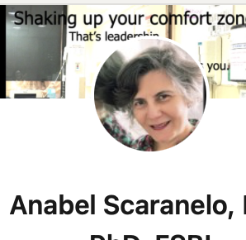
WHO WE ARE ?
The DATA Detectives
ZAID AL DULAIMI - TORONTO
LINTU BABY – WOODSTOCK
ANUMTA Khan – BRAMPTON
ANABEL SCARANELO – TORONTO

Slide 3

Disclosures
We do not have any financial interests.

Slide 4

Our goals
Identify
Identify the types of crimes in Toronto.
Analyze
Analyze the trend across the timeline and neighborhoods.
Create
Create awareness about the results of our data analysis and make you feel safer.

Slide 5
Learning Objectives
After this presentation you will know…
What are the top 3 most committed crimes
during the last 8 years.
What were the trends across past years. Can we predict next year ?
What premises type those crimes
happened.
What time of the day they were
prevalent.
What neighborhoods showed the
highest number of crimes?

Slide 6

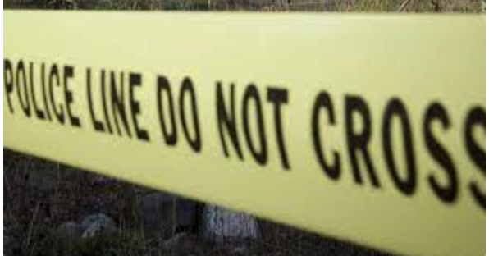
Brief Overview: API Toronto Police CSV files top 3 crimes
Used Jupyter Notebook for coding
URL = https://data.torontopolice.on.ca/pages/open-data

Slide 7
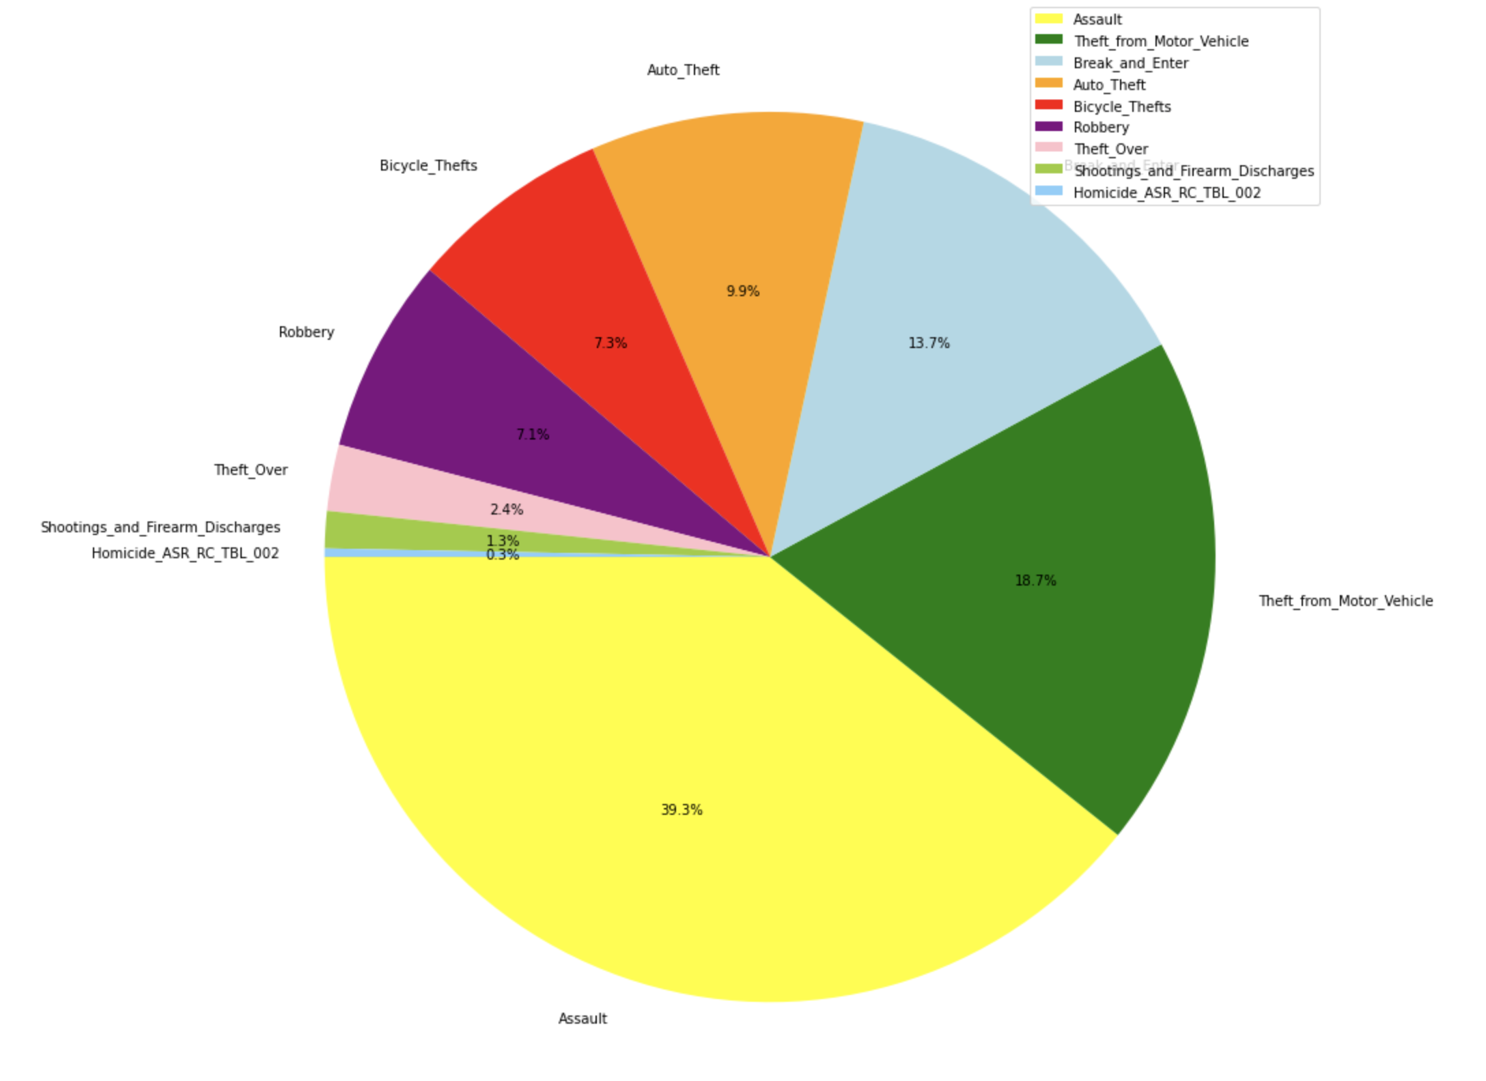
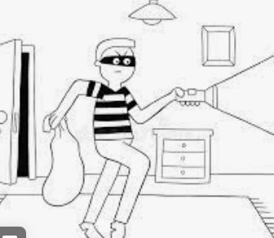


CRIME ANALYSIS

Slide 8
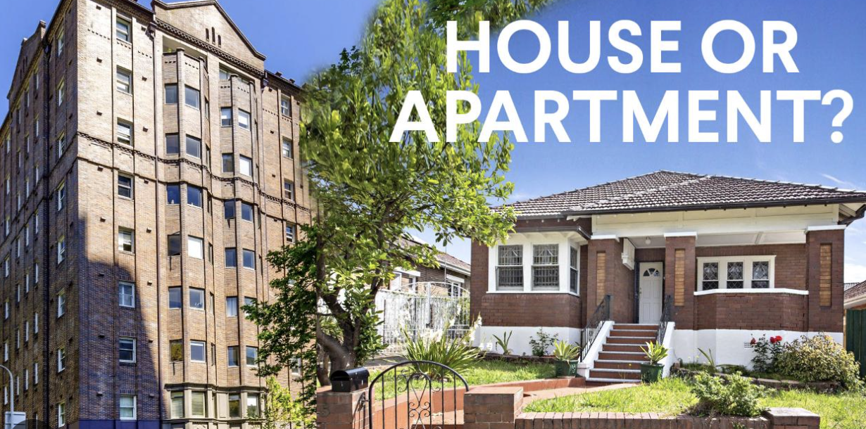
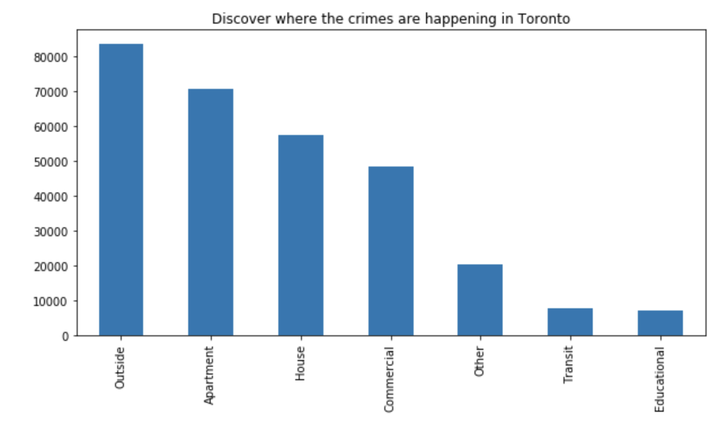
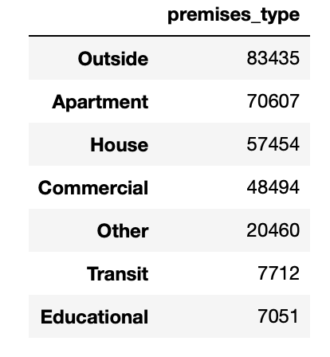

Slide 9

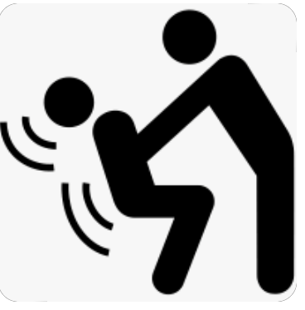
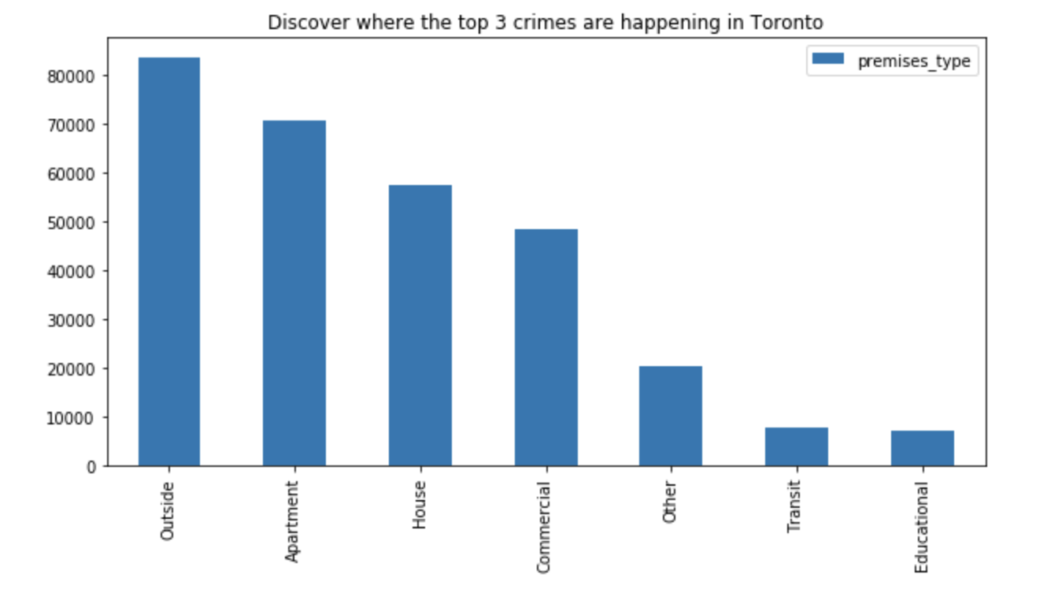
Data collection (combined top 3):
2014 to 2022

Slide 10
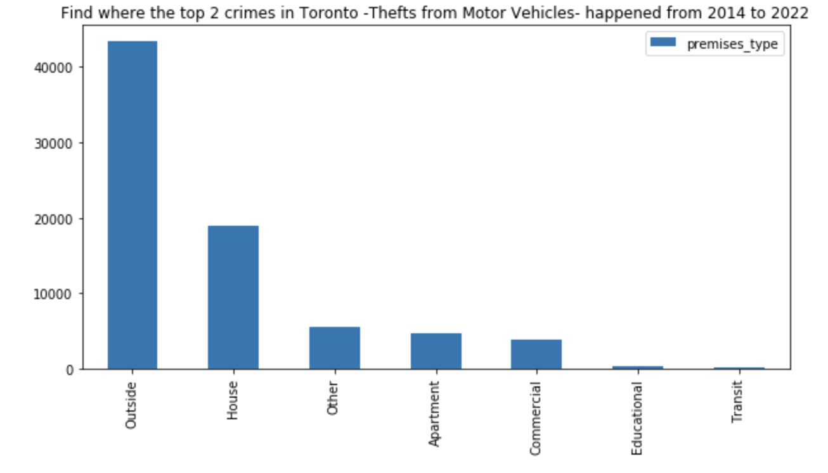
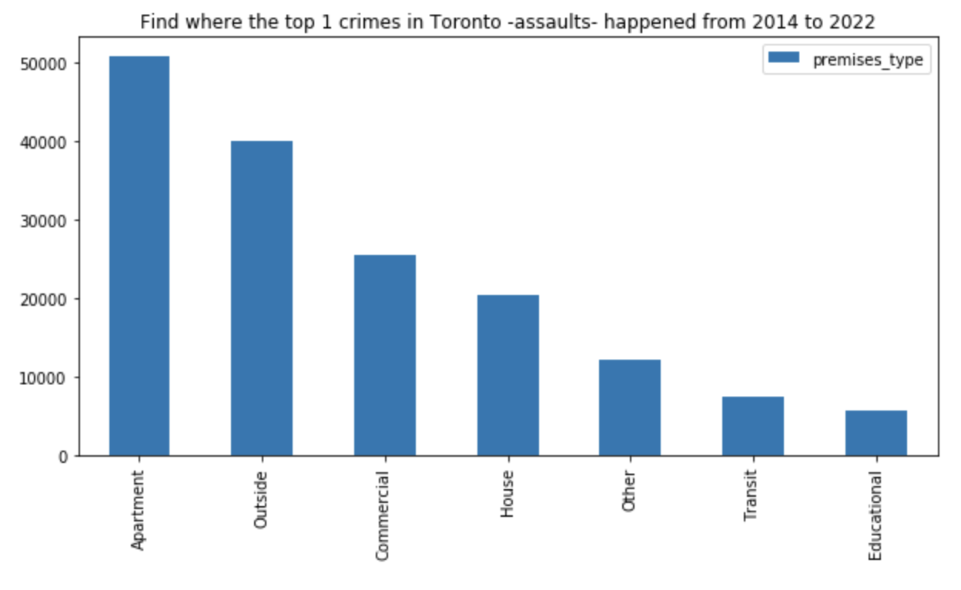
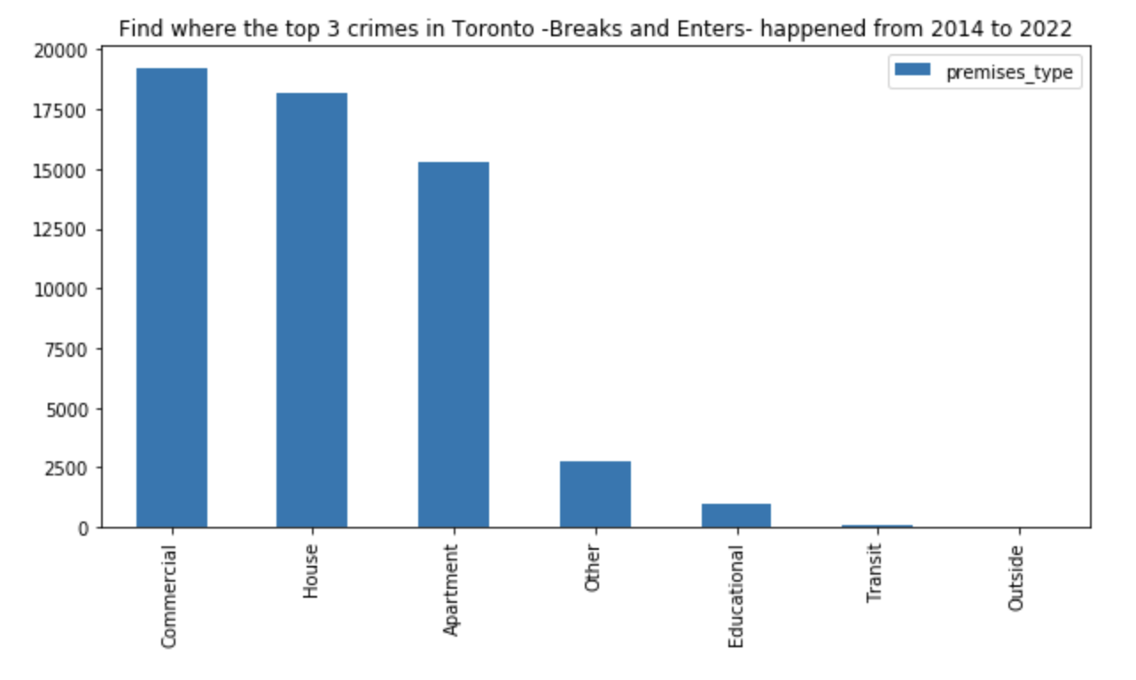
Data collection (not merged):
2014 to 2022
Thefts from MV
Assaults
Breaks and Enters

Slide 11
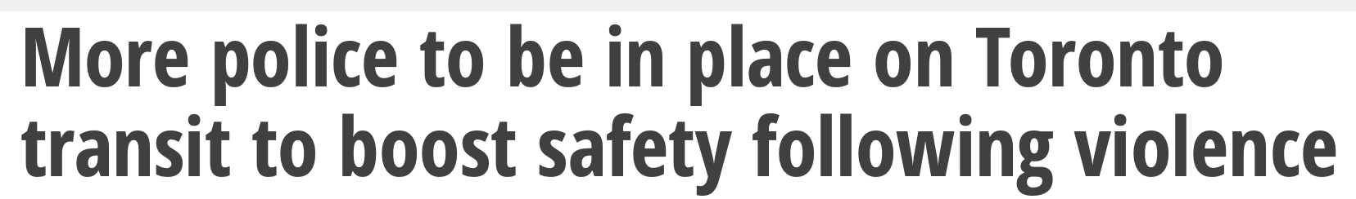

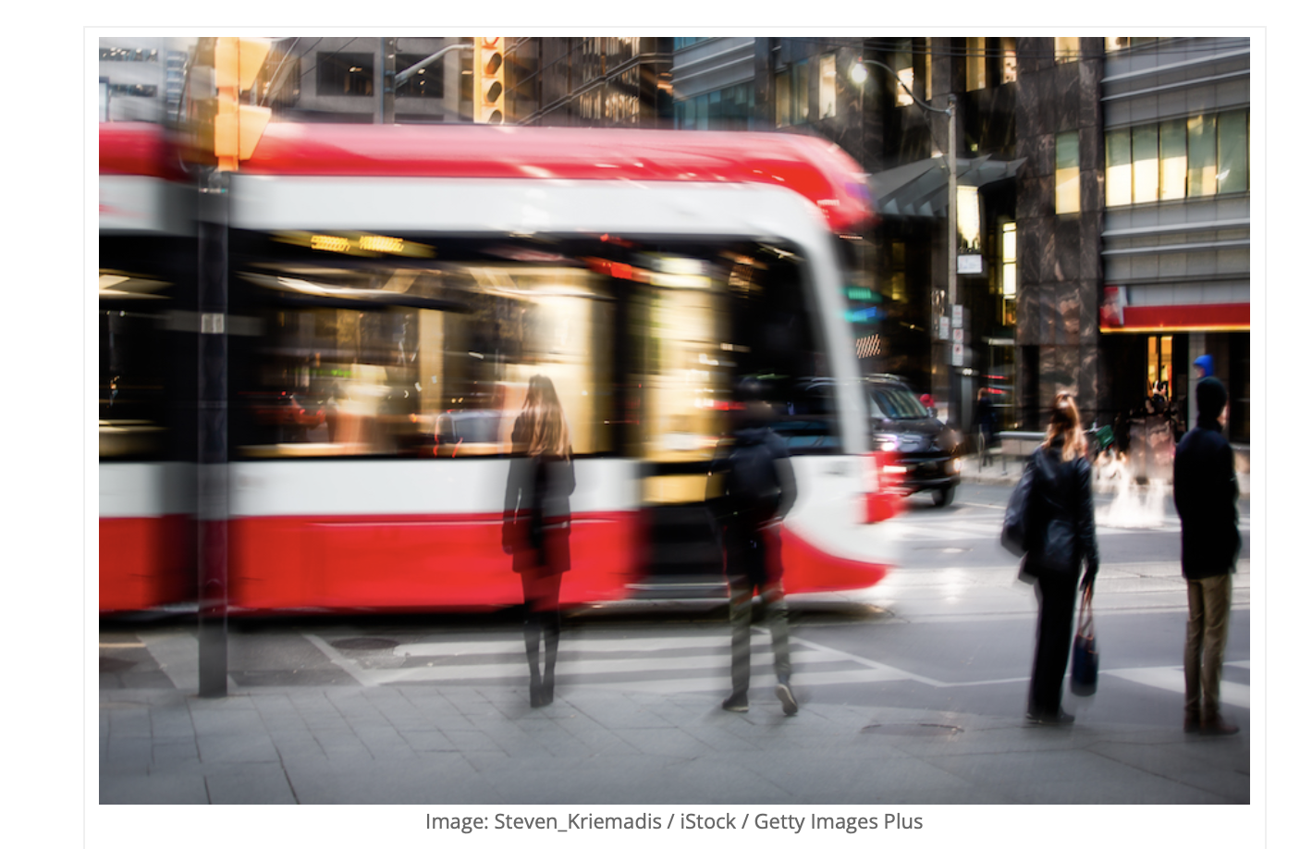

5
https://www.canadiansecuritymag.com/canadian-security-top-10-under-40-2023-now-open-for-nominations/

Slide 12
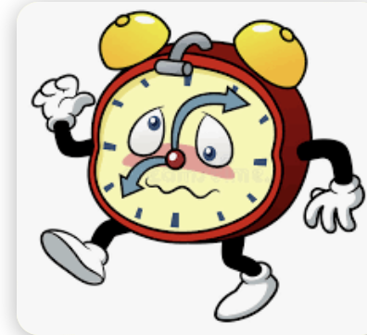
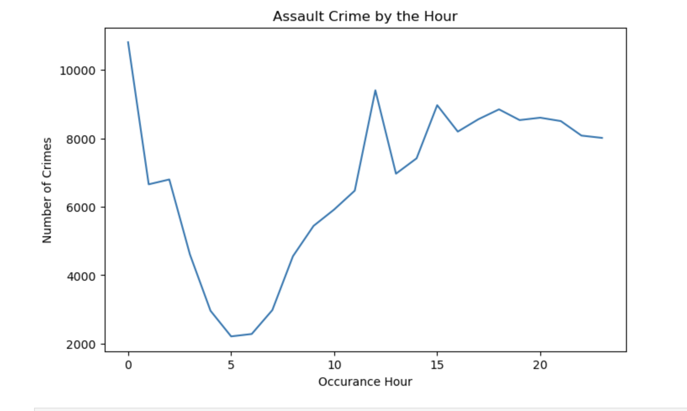
What do you think it is the most frequent time that Assault crime happens?

Slide 13

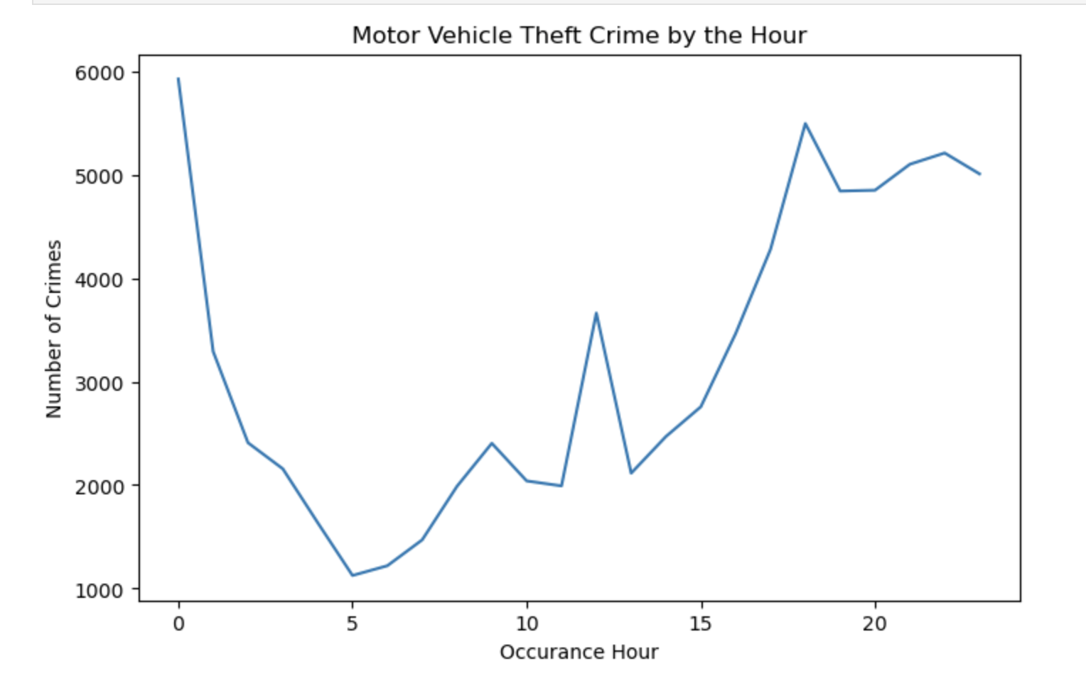
What do you think it is the most frequent time that MV Theft crime happens

Slide 14

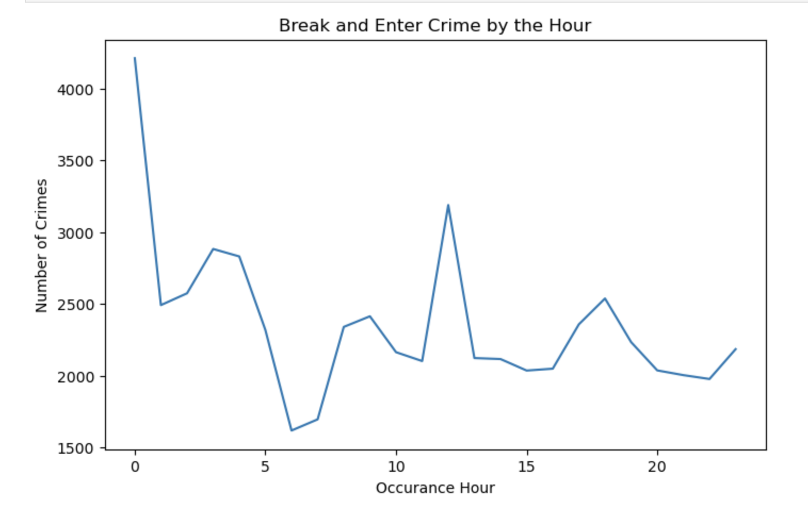
What do you think it is the most frequent time that Break and Enter crime happens

Slide 15
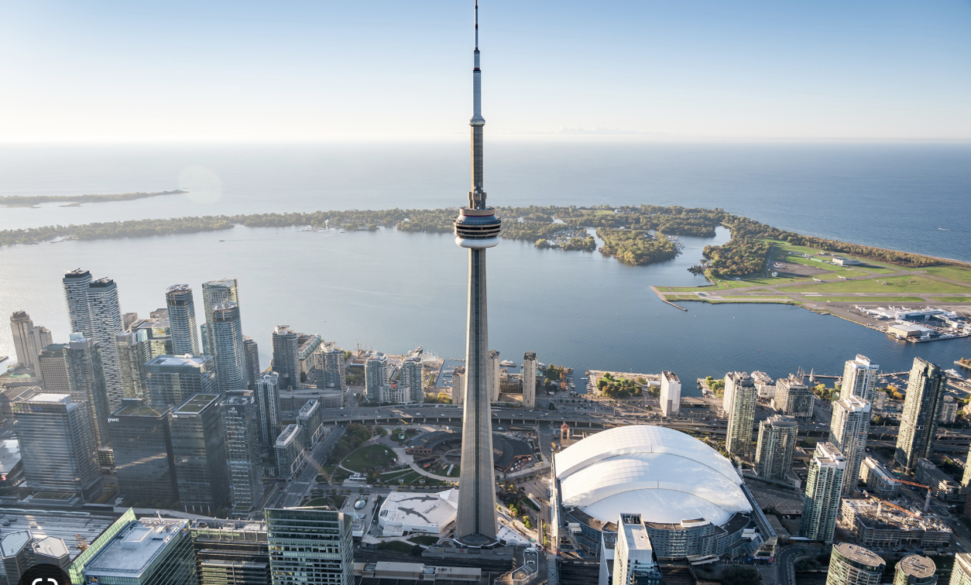
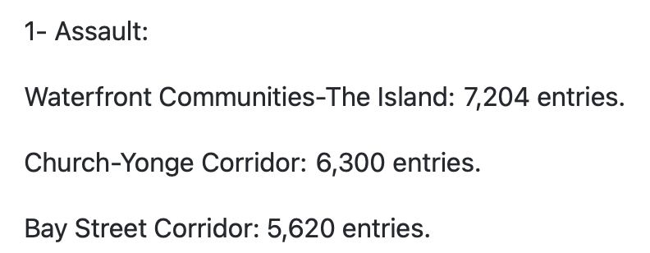
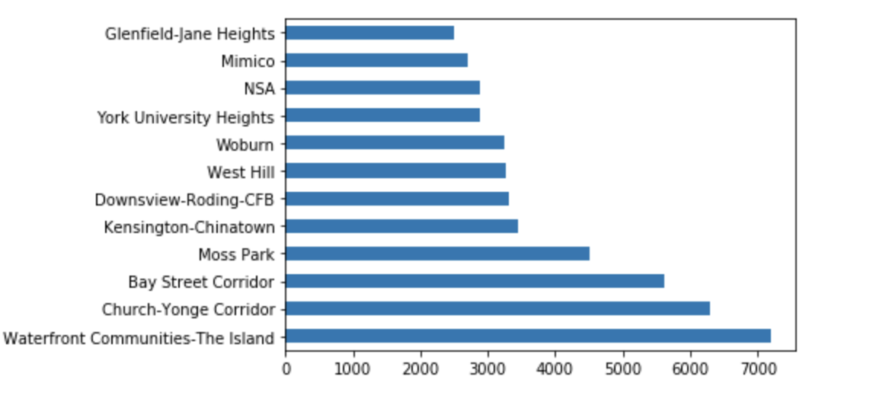
Assaults by Neighbourhood

Slide 16
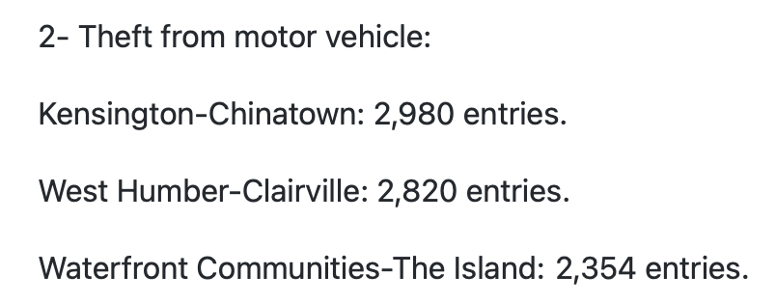
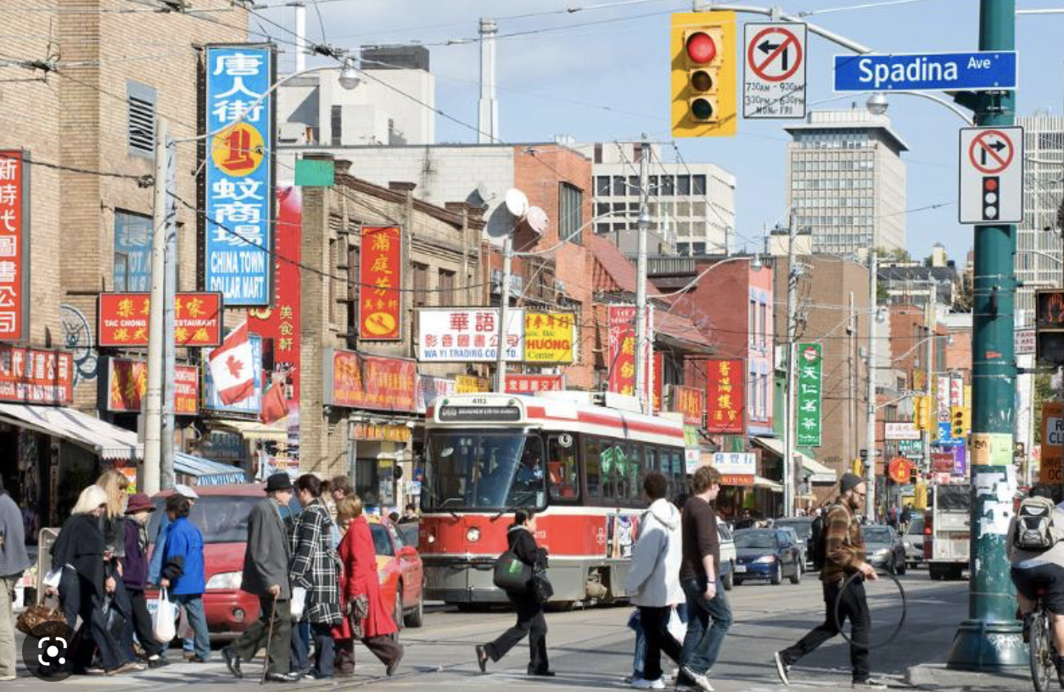
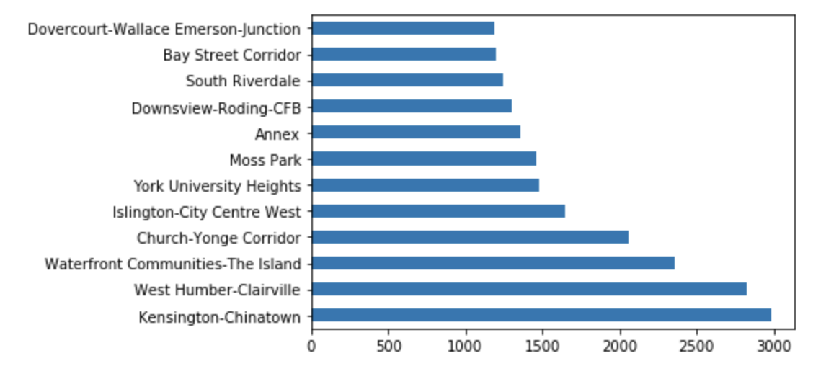
Thefts from MV by Neighbourhood

Slide 17
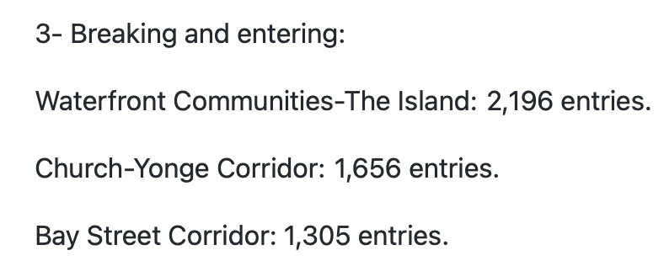
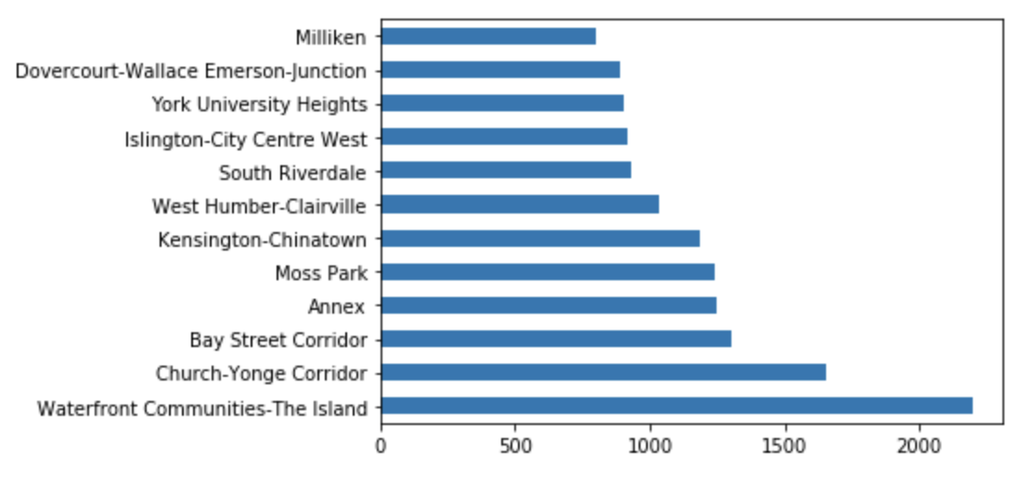
Breaking and entering by Neighbourhood:

Slide 18
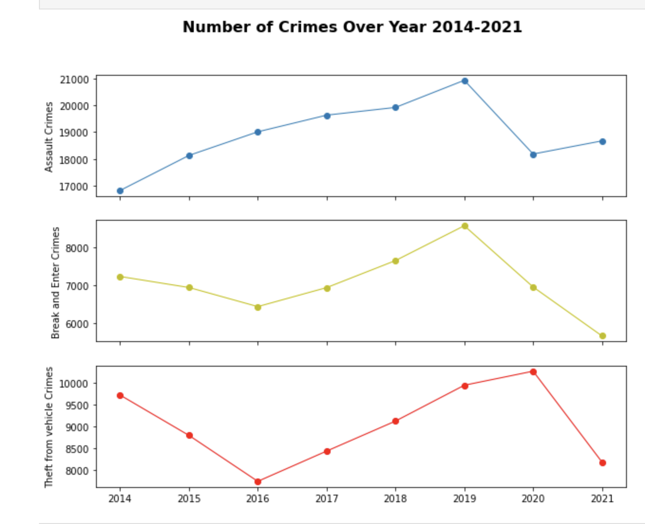

Slide 19
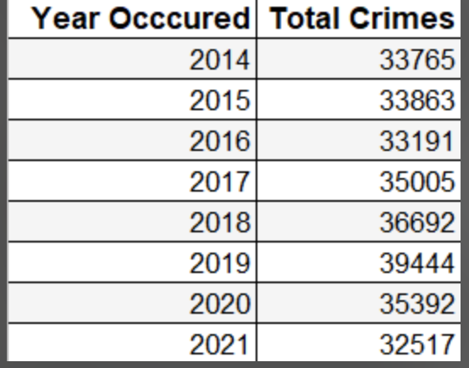
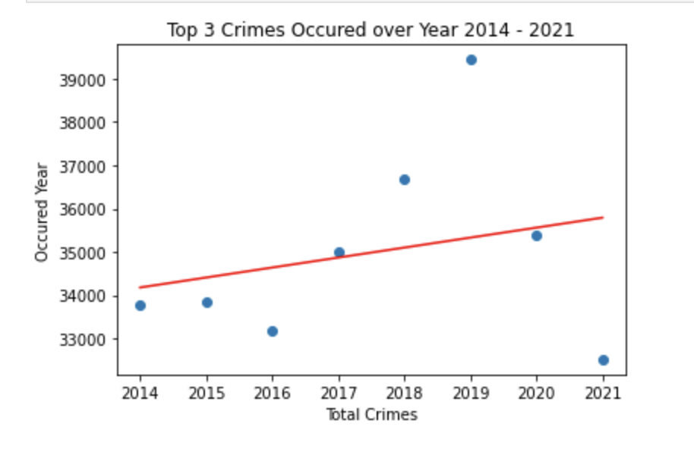

Slide 20


The number of crimes in 2023 forecasted as per this data analysis
will be of 36,251.

Slide 21

TAKE HOME LESSION:
You will be the “safest” when you spend your time outside, specifically at 12am, at the Waterfront communities!

Slide 22




